Slide 1


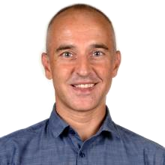
Lecture 7b
The Transformer
Master in Big Data Solutions 2020-2021 - Artificial Intelligence
Xavier Giró
xavier.giro@bts.tech

Slide 2
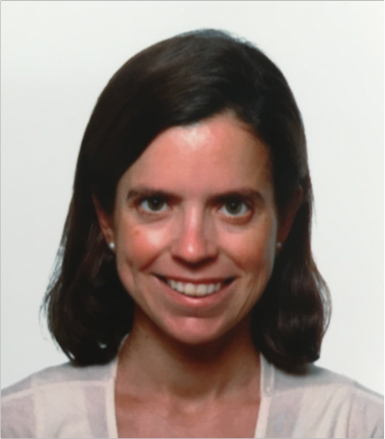


Acknowledgments
Marta R. Costa-jussà
Carlos Escolano
Associate Professor
Universitat Politècnica de Catalunya
PhD Candidate
Universitat Politècnica de Catalunya

Slide 3
Outline
Reminders

Slide 4
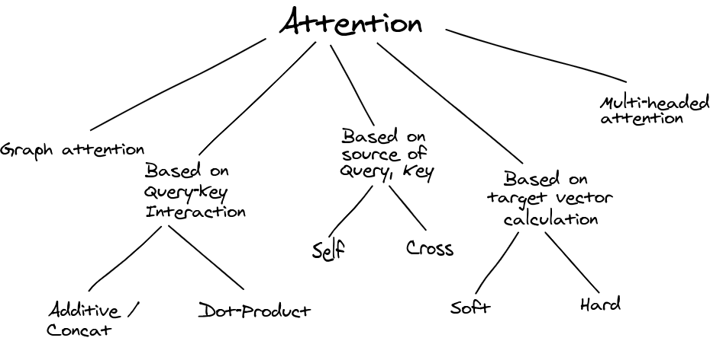
Reminder
Nikhil Sha, “Attention ? An other Perspective!”. 2020.

Slide 5
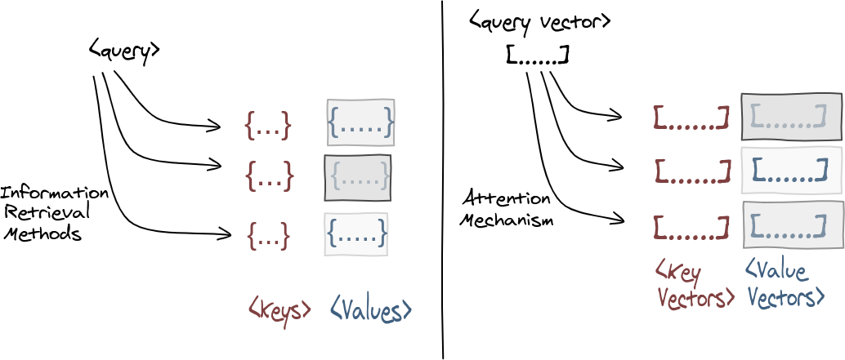
Reminder
Attention is a mechanism to compute a context vector (c) for a query (Q) as a weighted sum of values (V).
Figure: Nikhil Shah, “Attention? An Other Perspective! [Part 1]” (2020)

Slide 6
Reminder
Nikhil Sha, “Attention ? An other Perspective!”. 2020.

Slide 7
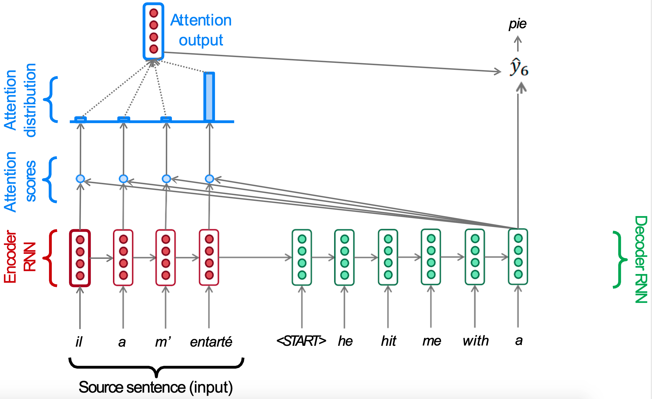
Reminder: Seq2Seq with Cross-Attention
In this case, cross-attention refers to the attention between the encoder and decoder states.
Slide concept: Abigail See, Matthew Lamm (Stanford CS224N), 2020

Slide 8
What may the term “self” refer to, as a contrast of “cross”-attention ?
Nikhil Sha, “Attention ? An other Perspective!”. 2020.

Slide 9
Outline
Motivation
Self-attention

Slide 10

Self-Attention (or intra-Attention)
Self-attention refers to attending to other elements from the SAME sequence.
Figure:
Jay Alammar,
“The Illustrated Transformer”
Lin, Z., Feng, M., Santos, C. N. D., Yu, M., Xiang, B., Zhou, B., & Bengio, Y. A structured self-attentive sentence embedding. ICLR 2017.

Slide 11
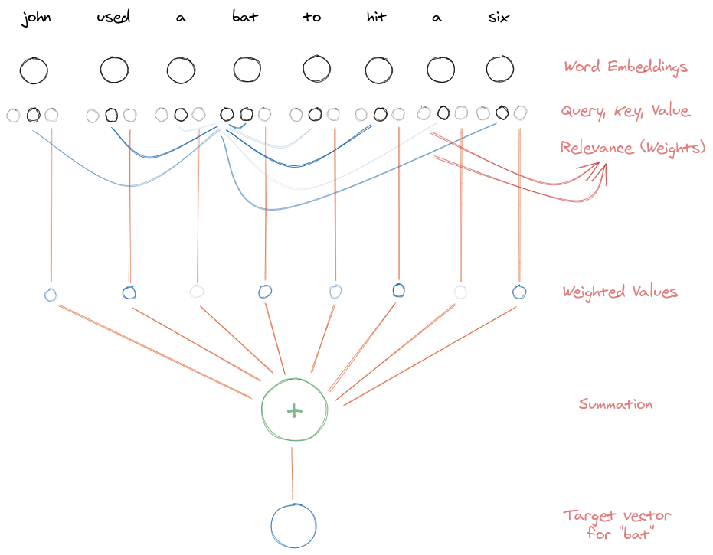
Self-Attention (or intra-Attention)
Query (Q)
g(x) = W^{Q} x
Key (K)
f(x) = W^{K} x
Value (V)
h(x) = W^{V} x
W^{Q}, W^{K} and W^{V} are projection layers shared across all words.
Nikhil Sha, “Attention ? An other Perspective!”. 2020.

Slide 12
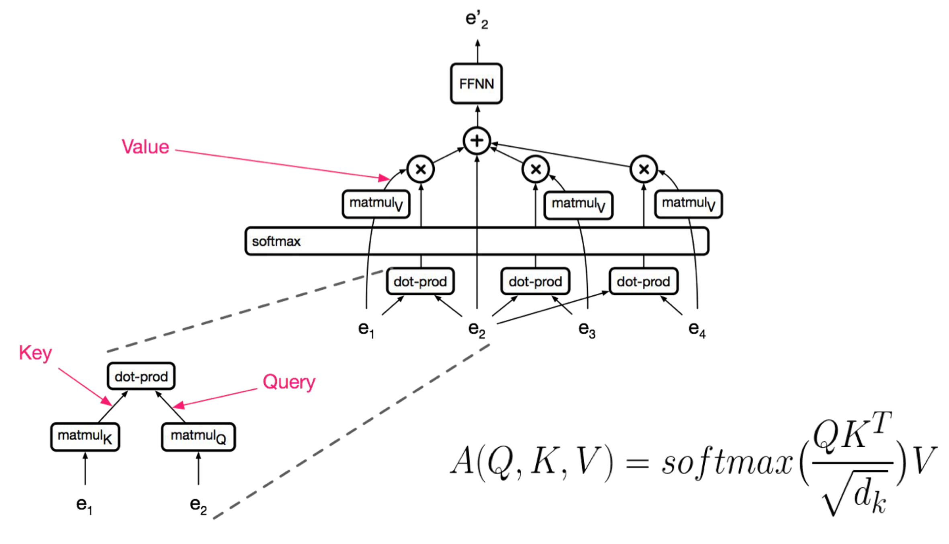
Self-Attention (or intra-Attention)
Which steps are necessary to compute the contextual representation of a word embedding e₂ in a sequences of four words embeddings (e₁, e₂, e₃, e₄) ?
A (scaled) dot-product is computed between each pair of word embeddings (eg. e₁ and e₂)...
#Transformer Vaswani, A., Shazeer, N., Parmar, N., Uszkoreit, J., Jones, L., Gomez, A. N., ... & Polosukhin, I.. Attention is all you need. NeurIPS 2017.

Slide 13
Self-Attention (or intra-Attention)
Which steps are necessary to compute the contextual representation of a word embedding e₂ in a sequences of four words embeddings (e₁, e₂, e₃, e₄) ?
… a softmax layer normalizes the attention scores to obtain the attention distribution...

Slide 14
Self-Attention (or intra-Attention)
Which steps are necessary to compute the contextual representation of a word embedding e₂ in a sequences of four words embeddings (e₁, e₂, e₃, e₄) ?
...the same word embeddings are combined to obtain the contextual representation e₂’.

Slide 15

Self-Attention (or intra-Attention)
Figure: Jay Alammar, “The illustrated Transformer” (2018)

Slide 16
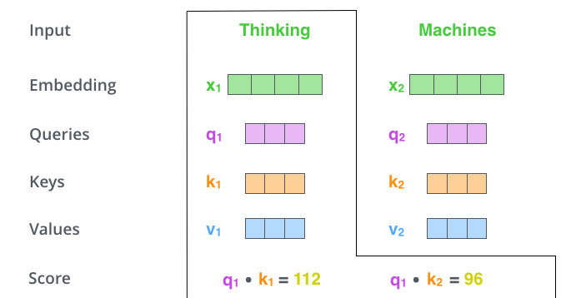
Self-Attention (or intra-Attention)
Figure: Jay Alammar, “The illustrated Transformer” (2018)

Slide 17
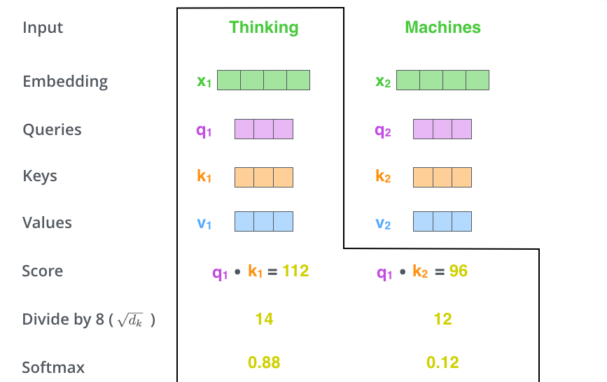
Self-Attention (or intra-Attention)
Figure: Jay Alammar, “The illustrated Transformer” (2018)

Slide 18

Self-Attention (or intra-Attention)
Figure: Jay Alammar, “The illustrated Transformer” (2018)

Slide 19
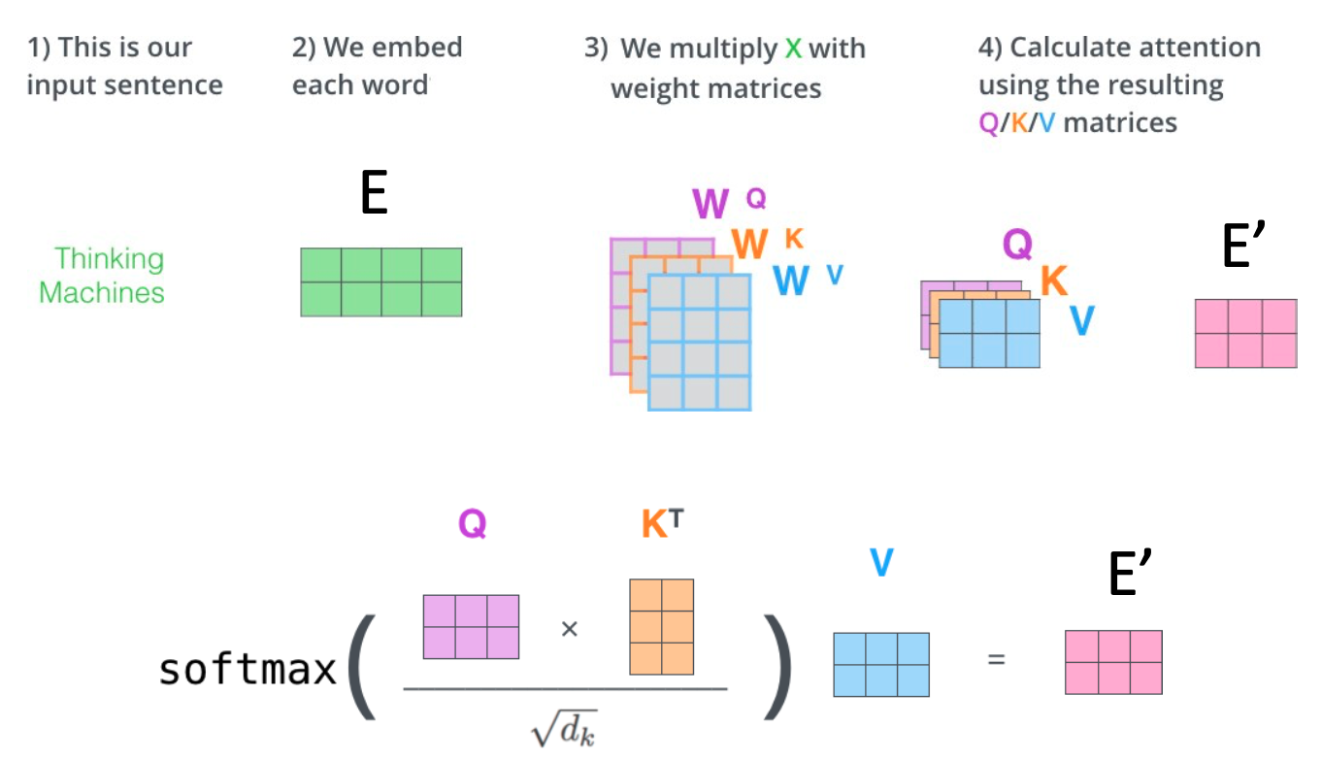
Self-Attention (or intra-Attention)
Figure: Jay Alammar, “The illustrated Transformer” (2018)

Slide 20
Self-Attention (or intra-Attention)
Figure: Jay Alammar, “The illustrated Transformer” (2018)

Slide 21
Self-Attention (or intra-Attention)
Figure: Jay Alammar, “The illustrated Transformer” (2018)

Slide 22
Self-Attention (or intra-Attention)
Figure: Jay Alammar, “The illustrated Transformer” (2018)

Slide 23
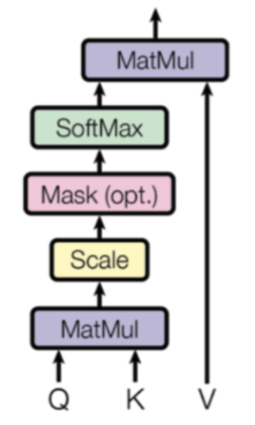
Self-Attention (or intra-Attention)
Scaled dot-product attention
Figure: Jay Alammar, “The illustrated Transformer” (2018)

Slide 24
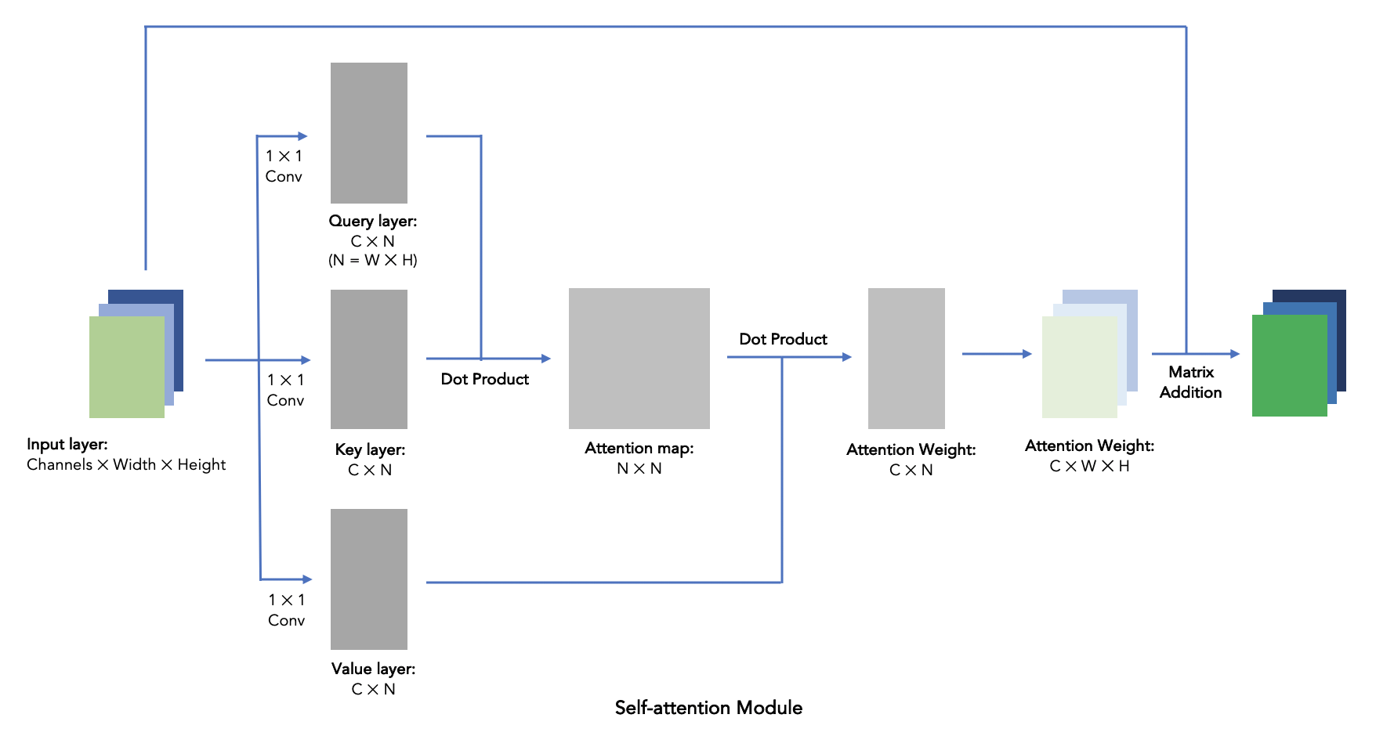
Study case: Self-Attention in images
Figure:
Frank Xu
#SAGAN Zhang, Han, Ian Goodfellow, Dimitris Metaxas, and Augustus Odena. "Self-attention generative adversarial networks." ICML 2019. [video]

Slide 25
Outline
Motivation
Self-attention
Multi-head Self-Attention (MHSA)

Slide 26
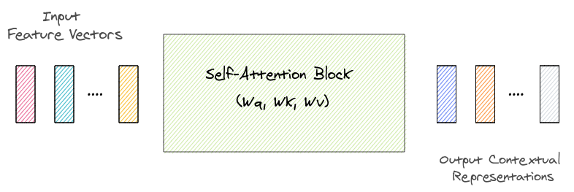
Multi-Head Self-Attention (MHSA)
In vanilla self-attention, a single set of projection matrices W^{Q}, W^{K}, W^{V} is used.
Nikhil Sha, “Attention ? An other Perspective!”. 2020.

Slide 27
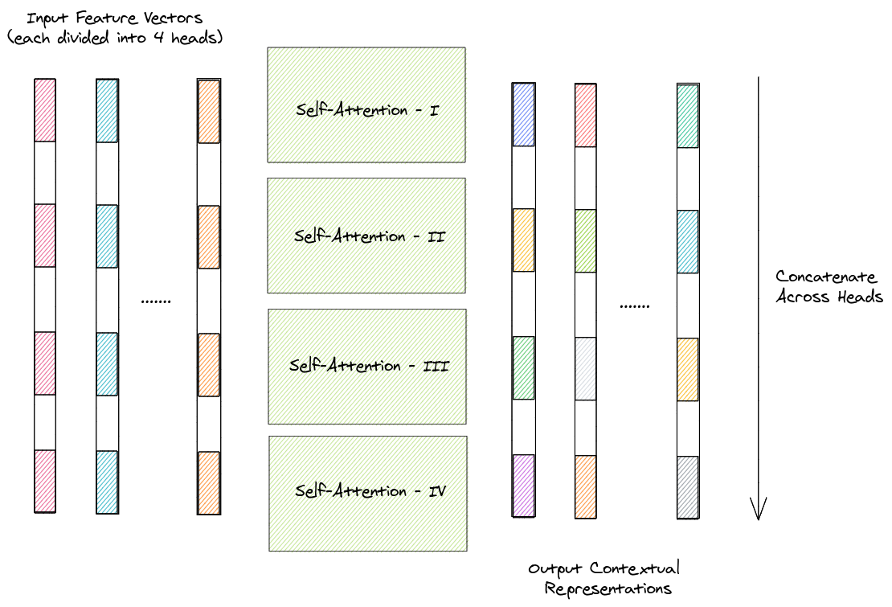
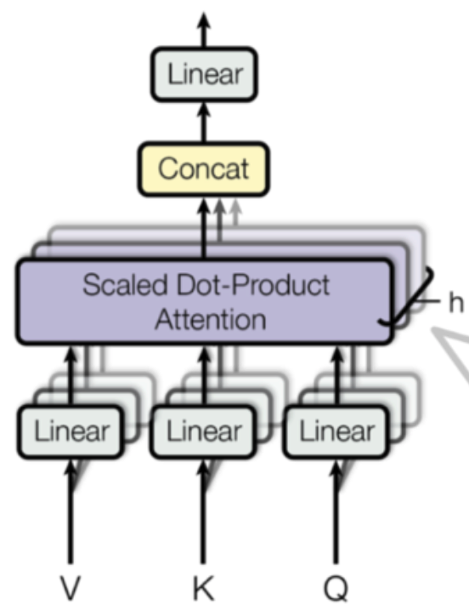
Multi-Head Self-Attention (MHSA)
In multi-head self-attention, mutiple sets of projection matrices are used, and can provide different contextual representations for the same input token.
Nikhil Sha, “Attention ? An other Perspective!”. 2020.

Slide 28
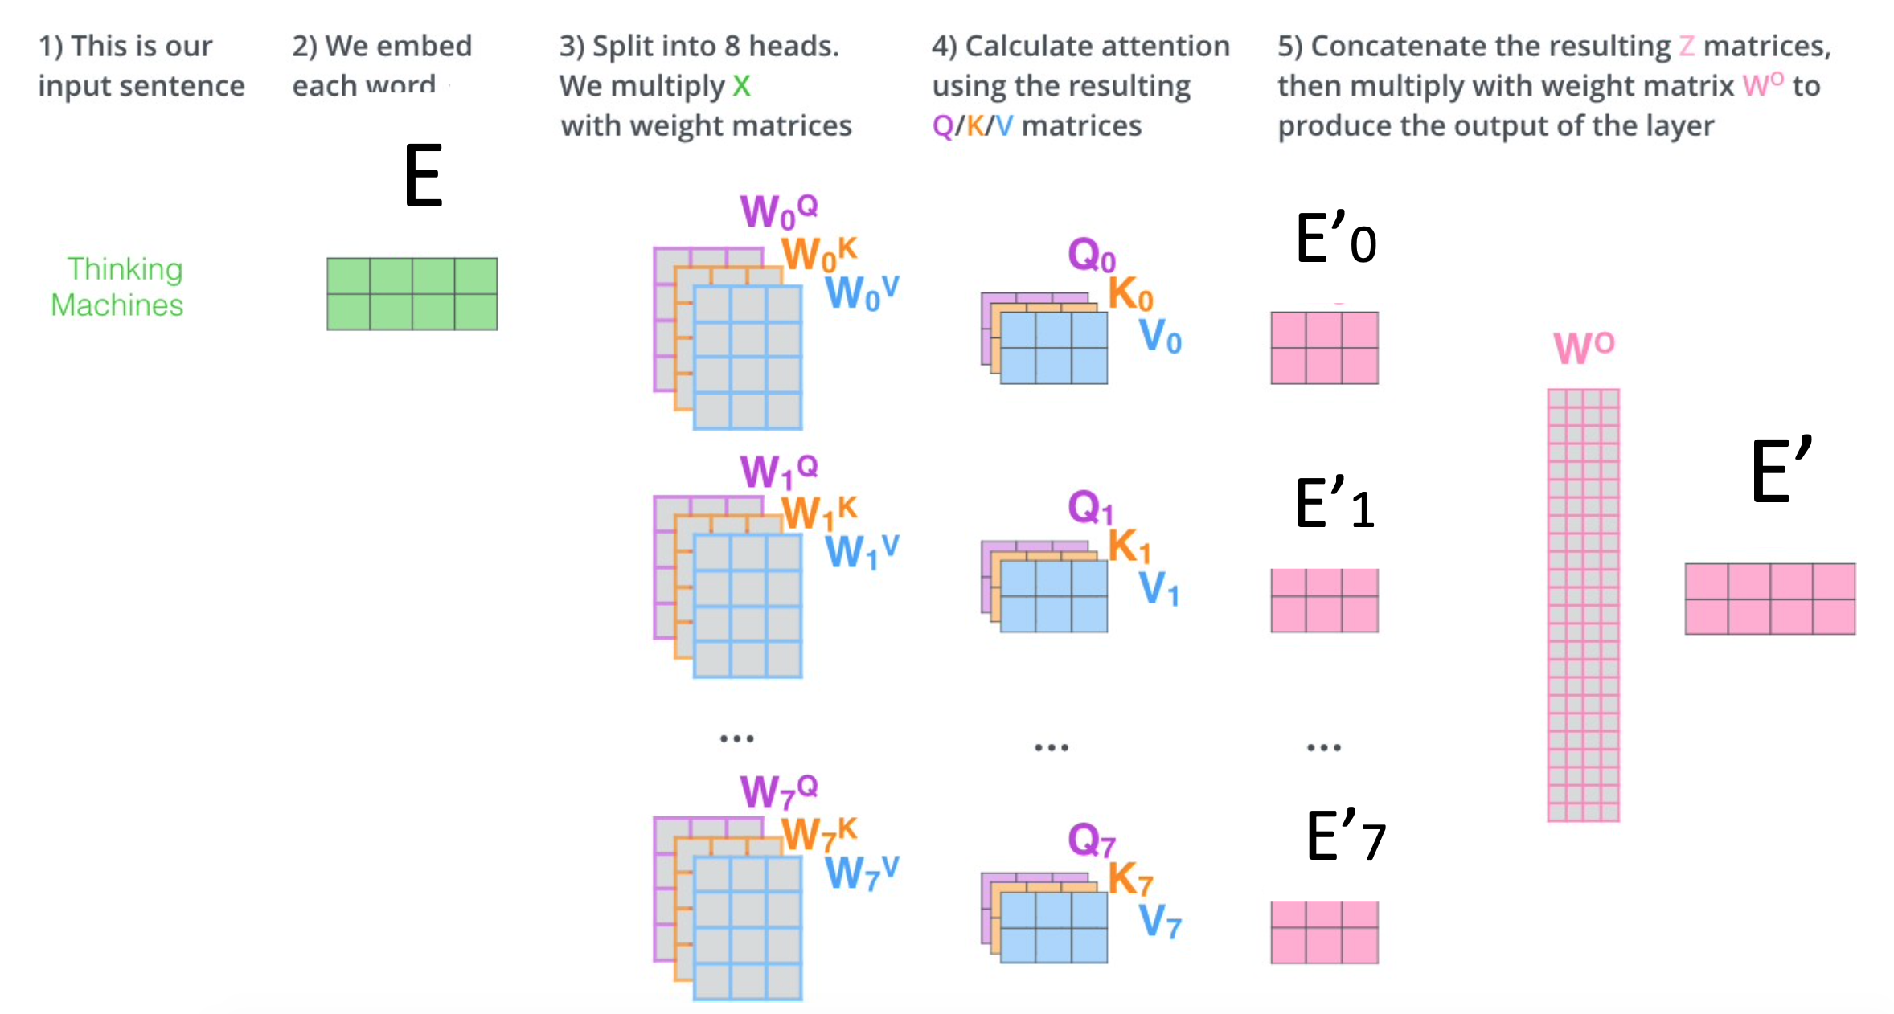
Multi-Head Self-Attention (MHSA)
The multi-headded self-attended E’_{i} matrixes are concatenated:
Figure: Jay Alammar, “The illustrated Transformer” (2018)

Slide 29
Multi-Head Self-Attention (MHSA)
A fully connected layer on top combines everything in a new E’.
Figure: Jay Alammar, “The illustrated Transformer” (2018)

Slide 30
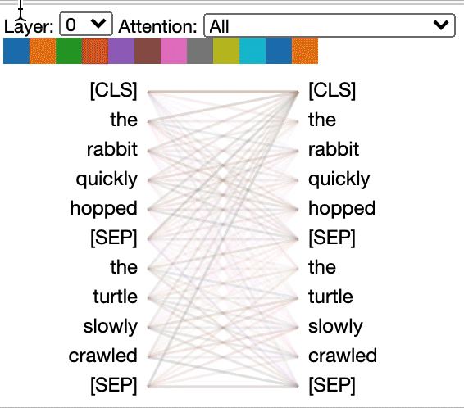
Multi-head Self-Attention: Visualization
Each colour corresponds to a head.
Blue: First head only.
Multi-color: Multiple heads.
#BertViz Vig, Jesse. "A multiscale visualization of attention in the transformer model." ACL 2019. [code] [tweet]

Slide 31
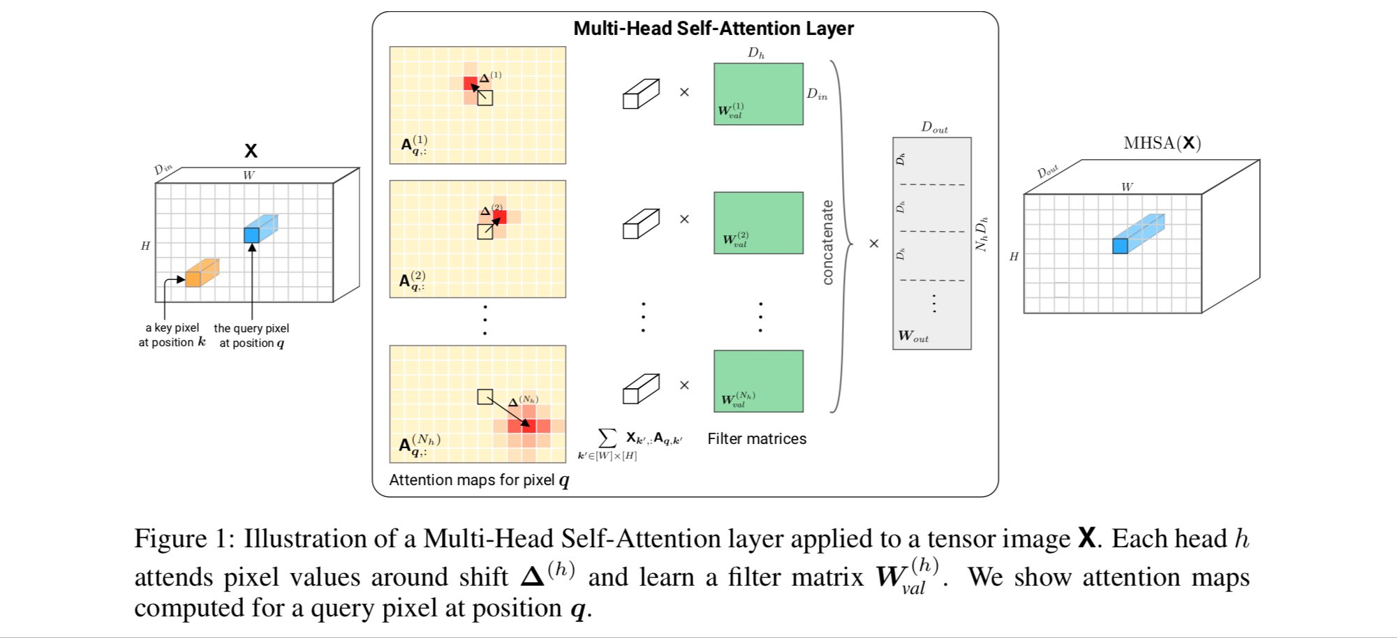
Self-Attention and Convolutional Layers
Cordonnier, J. B., Loukas, A., & Jaggi, M. On the relationship between self-attention and convolutional layers. ICLR 2020. [tweet] [code]

Slide 32
Outline
Motivation
Self-attention
Multi-head Attention
Positional Encoding

Slide 33
Positional Encoding
Given that the attention mechanism allows accessing all input (and output) tokens, we no longer need a memory through recurrent layers.

Slide 34
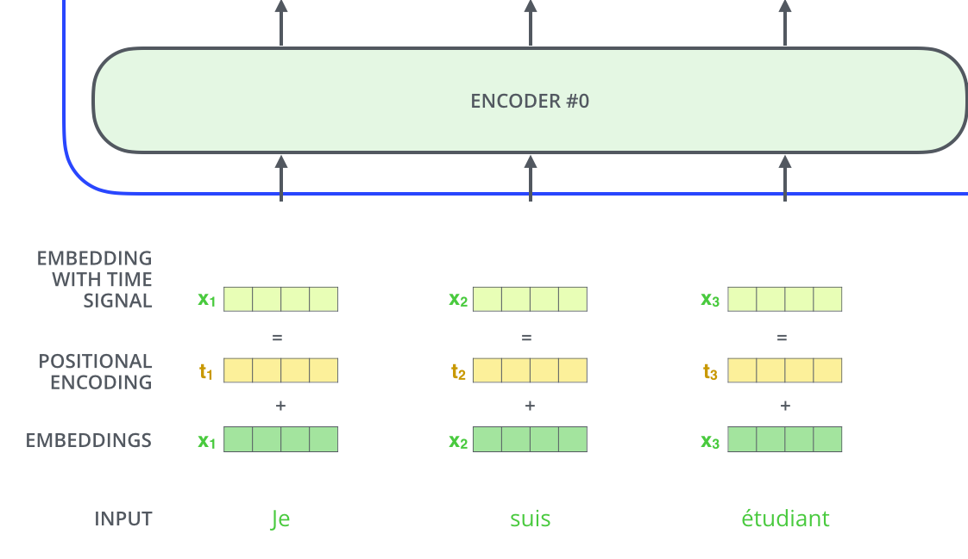
Positional Encoding
Where is the relative relation in the sequence encoded ?
Figure: Jay Alammar, “The illustrated Transformer” (2018)

Slide 35
Positional Encoding
Where is the relative relation in the sequence encoded ?
Figure: Jay Alammar, “The illustrated Transformer” (2018)

Slide 36
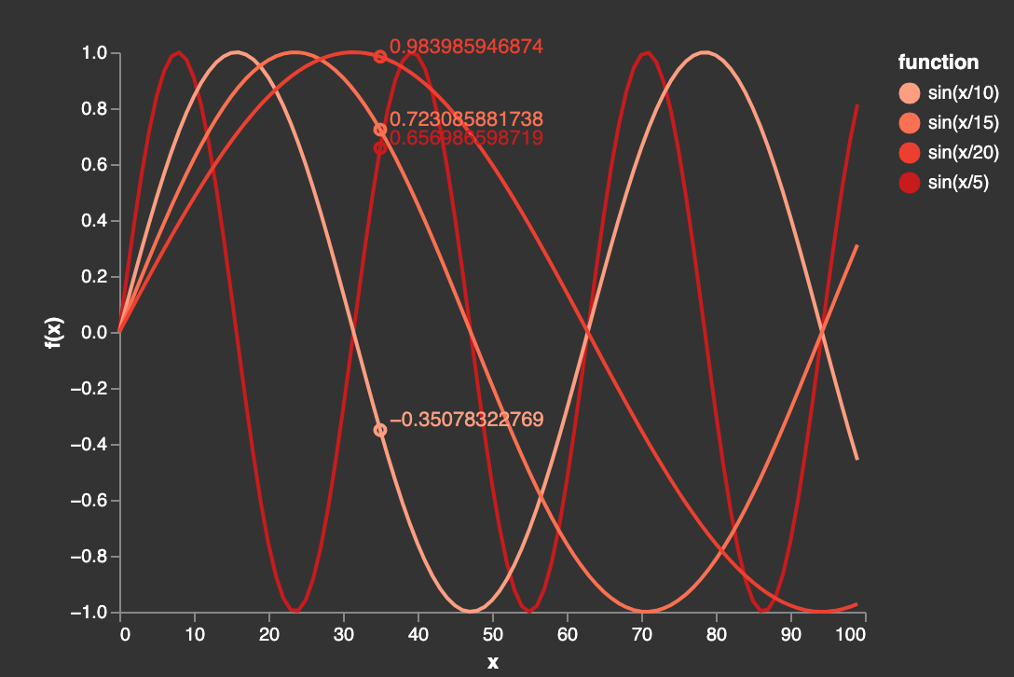
Positional Encoding
Sinusoidal functions are typically used to provide positional encodings.
Maria Ribalta, Pere-Pau Vàzquez, “Visualization is all you need”. UPC GCED 2020.

Slide 37
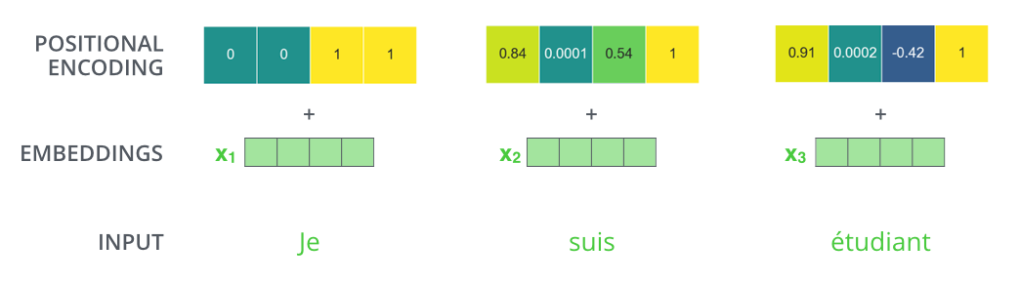
Positional Encoding
Figure: Jay Alammar, “The illustrated Transformer” (2018)

Slide 38
Outline
Motivation
Self-attention
Multi-head Attention
Positional Encoding
The Transformer

Slide 39
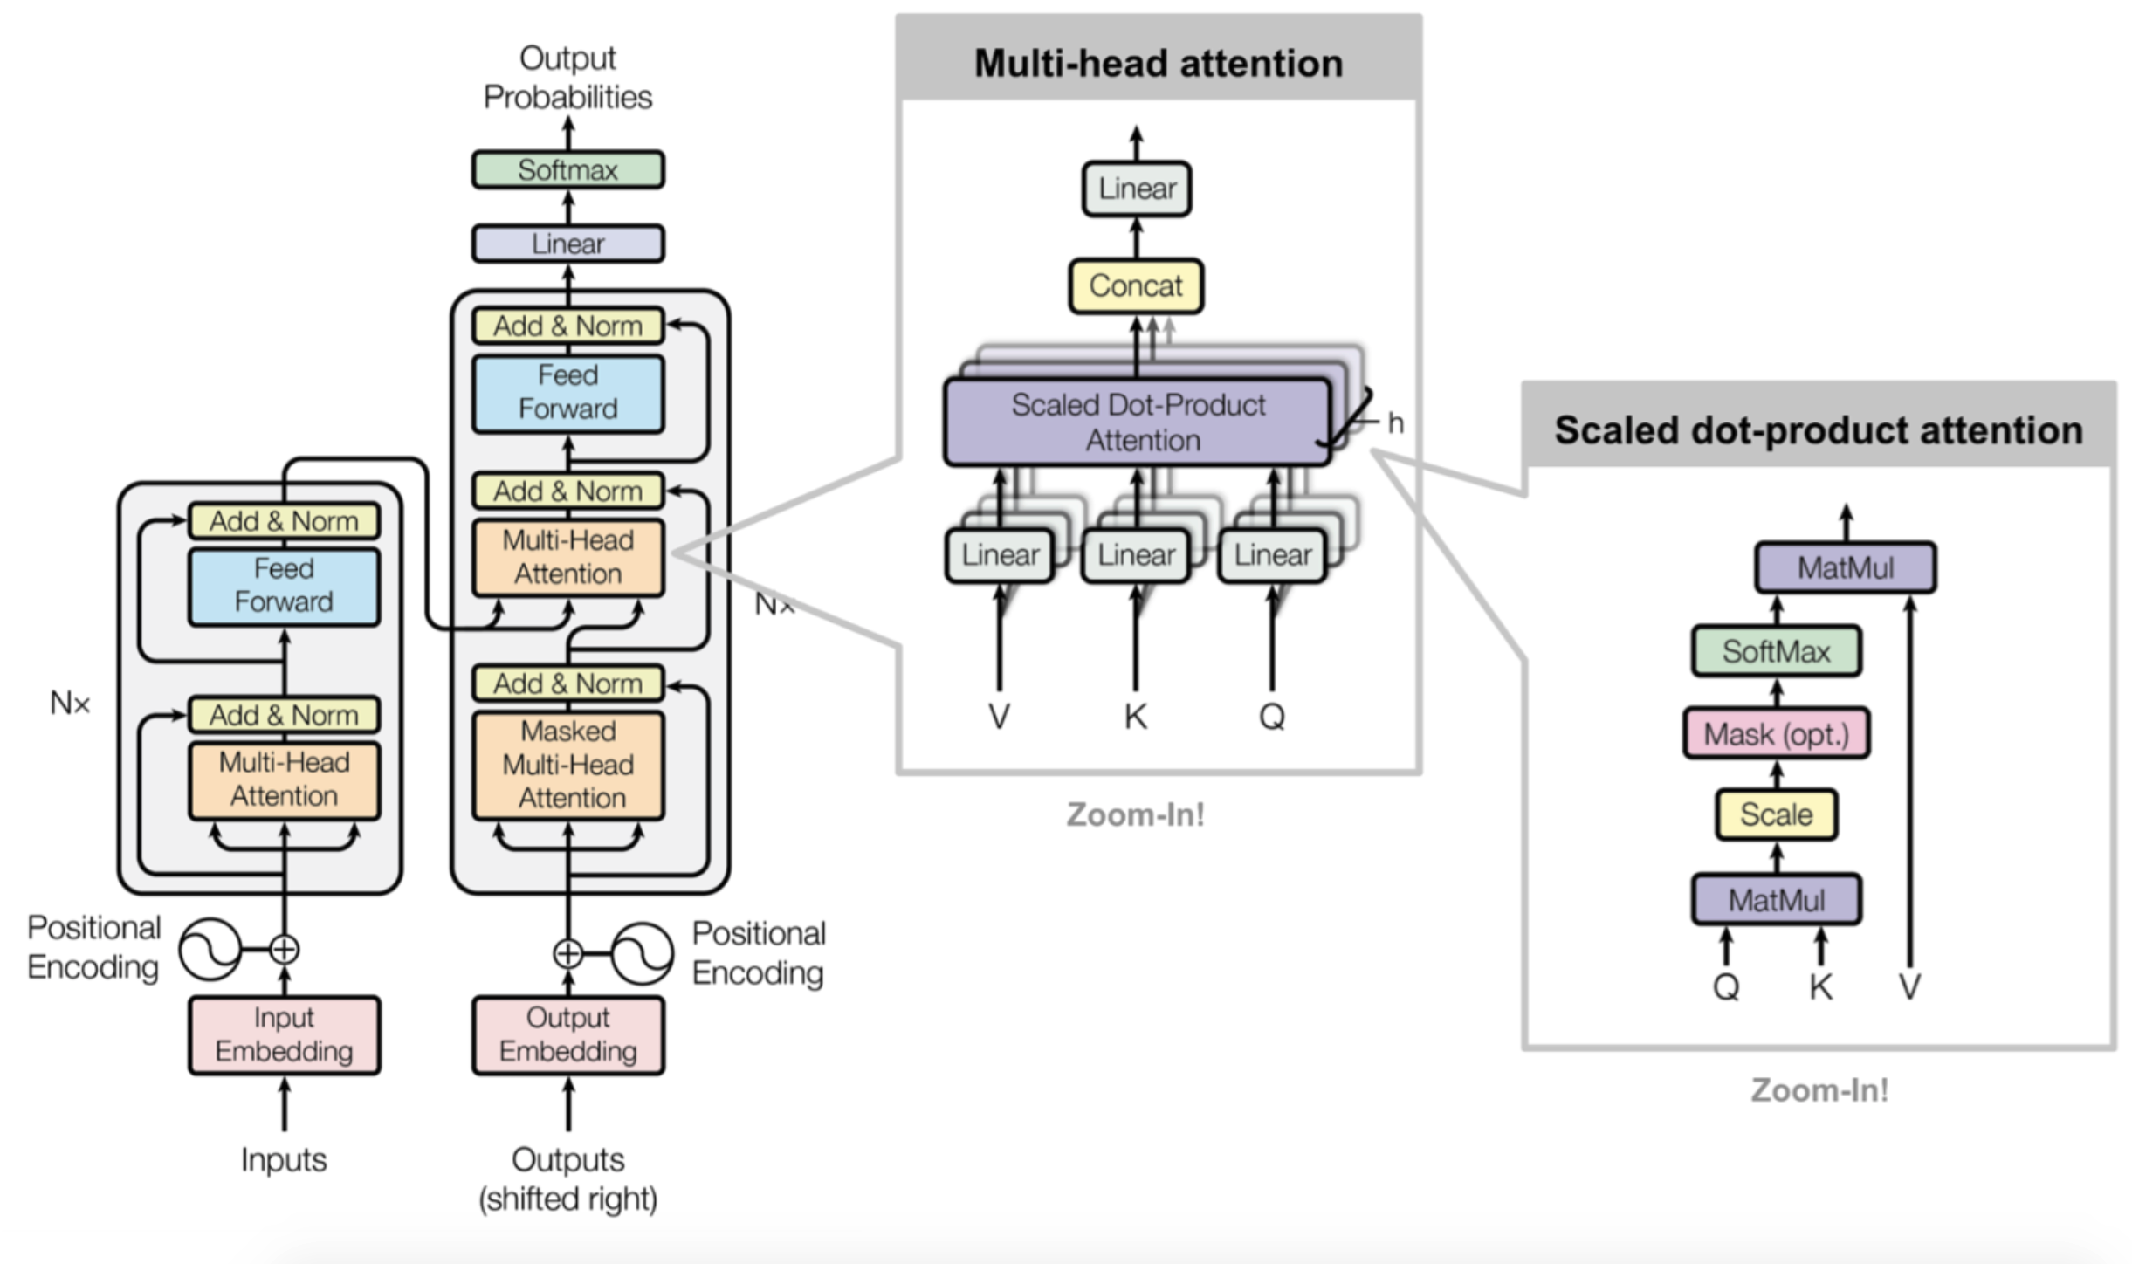
The Transformer
The Transformer was a revolutionary architecture that removed the recurrent layers to process sequences.
#Transformer Vaswani, A., Shazeer, N., Parmar, N., Uszkoreit, J., Jones, L., Gomez, A. N., ... & Polosukhin, I.. Attention is all you need. NeurIPS 2017.

Slide 40
The Transformer
The Transformer was a revolutionary architecture that removed the recurrent layers to process sequences.
Self-attention for the input tokens.
Cross-Attention (or inter-attention) between input and output tokens
Self-attention for the output tokens.
#Transformer Vaswani, A., Shazeer, N., Parmar, N., Uszkoreit, J., Jones, L., Gomez, A. N., ... & Polosukhin, I.. Attention is all you need. NeurIPS 2017.

Slide 41
The Transformer: Layers
N encoder layers
N decoder layers
#Transformer Vaswani, A., Shazeer, N., Parmar, N., Uszkoreit, J., Jones, L., Gomez, A. N., ... & Polosukhin, I.. Attention is all you need. NeurIPS 2017.

Slide 42
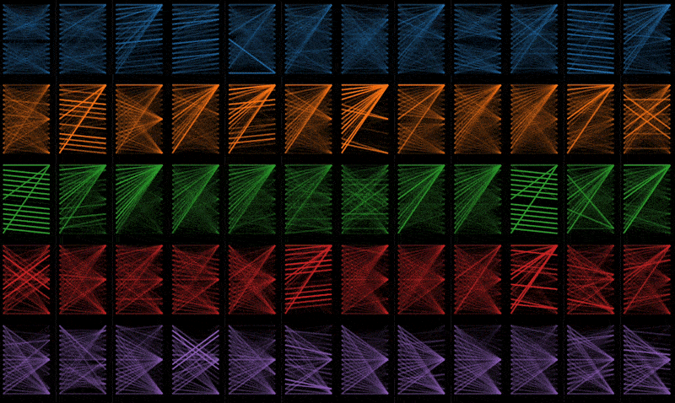
The Transformer: Layers
A birds-eye view of attention across all of the model’s layers and heads
#BertViz Vig, Jesse. "A multiscale visualization of attention in the transformer model." ACL 2019. [code] [tweet]

Slide 43
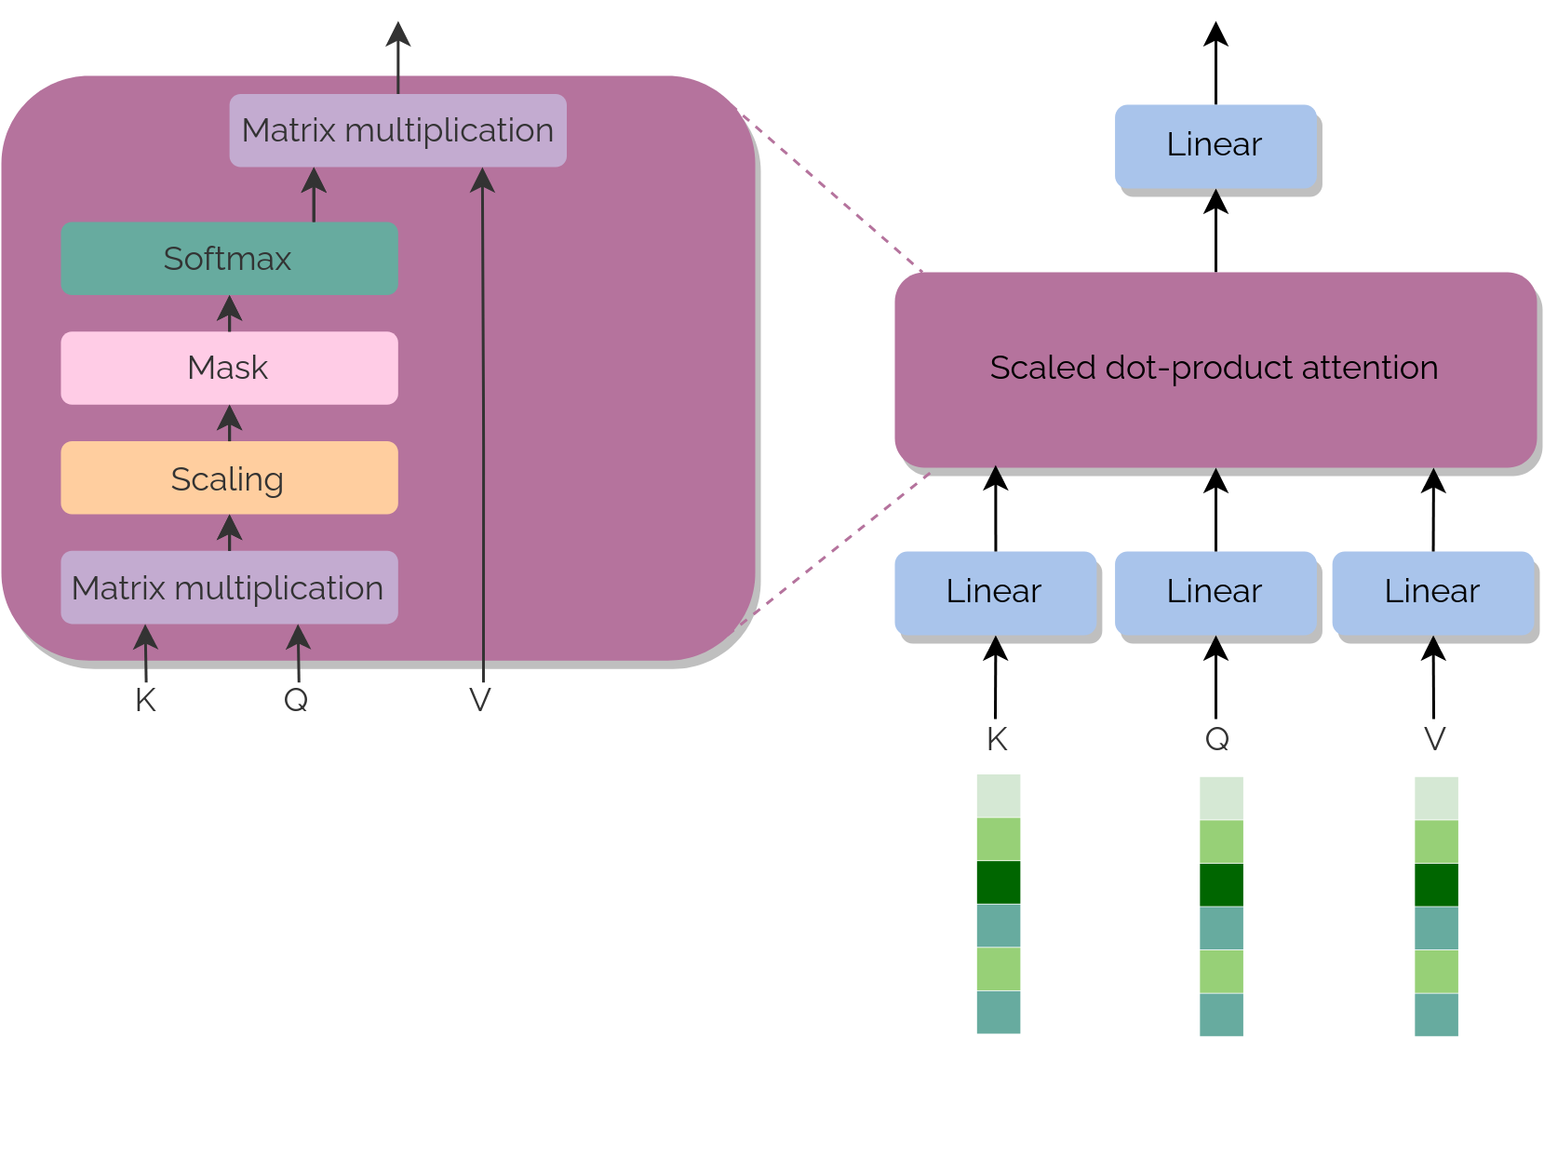
The Transformer: Visualization
Maria Ribalta, Pere-Pau Vàzquez, “Visualization is all you need”. UPC GCED 2020.

Slide 44
Outline
Motivation
Self-attention
Multi-head Attention
Positional Encoding
The Transformer

Slide 45

Are Transformers for Language only ? NO !!
#ViT Dosovitskiy, Alexey, Lucas Beyer, Alexander Kolesnikov, Dirk Weissenborn, Xiaohua Zhai, Thomas Unterthiner, Mostafa Dehghani et al. "An image is worth 16x16 words: Transformers for image recognition at scale." arXiv preprint arXiv:2010.11929 (2020). [blog] [code]

Slide 46
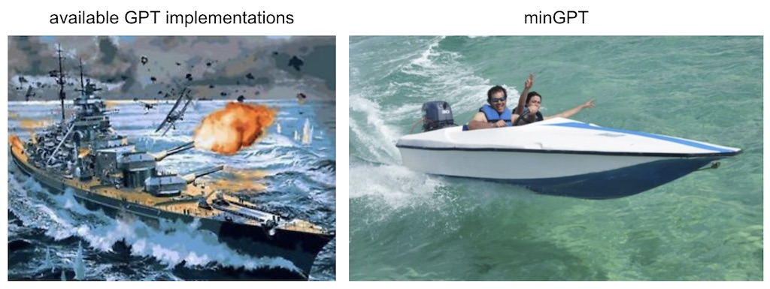
Software
GPT-Neo by EleutherAI
Similar results to GPT-3, but smaller and open source.
Transformers in HuggingFace.
Andrej Karpathy, minGPT (2020).

Slide 47
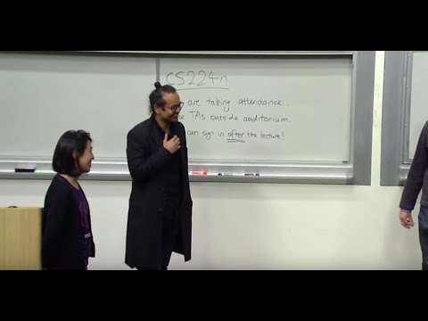
Learn more
Ashihs Vaswani, Stanford CS224N 2019.

Slide 48
Learn more
Tutorials
Sebastian Ruder, Deep Learning for NLP Best Practices # Attention (2017).
Chris Olah, Shan Carter, “Attention and Augmented Recurrent Neural Networks”. distill.pub 2016.
Demos
François Fleuret (EPFL)
Twitter threads
Christian Wolf (INSA Lyon)
Scientific publications
Katharopoulos, A., Vyas, A., Pappas, N., & Fleuret, F. (2020). Transformers are rnns: Fast autoregressive transformers with linear attention. ICML 2020.
Siddhant M. Jayakumar, Wojciech M. Czarnecki, Jacob Menick, Jonathan Schwarz, Jack Rae, Simon Osindero, Yee Whye Teh, Tim Harley, Razvan Pascanu, “Multiplicative Interactions and Where to Find Them”. ICLR 2020. [tweet]
Self-attention in language
Cheng, J., Dong, L., & Lapata, M. (2016). Long short-term memory-networks for machine reading. arXiv preprint arXiv:1601.06733.
Self-attention in images
Parmar, N., Vaswani, A., Uszkoreit, J., Kaiser, Ł., Shazeer, N., Ku, A., & Tran, D. (2018). Image transformer. ICML 2018.
Wang, Xiaolong, Ross Girshick, Abhinav Gupta, and Kaiming He. "Non-local neural networks." In CVPR 2018.
#SAGAN Zhang, Han, Ian Goodfellow, Dimitris Metaxas, and Augustus Odena. "Self-attention generative adversarial networks." ICML 2019. [video]

Slide 49

Questions ?

